Slide 1
INTRODUCTION
GRAD 695: Research Methodology and Writing
Harrisburg University
Arnie Miles

Slide 2
SYLLABUS REVIEW

Slide 3
COURSE DESCRIPTION
This course is intended to assist you in preparing your thesis proposal, which is the experiential capstone of your graduate studies in analytics.
  We will review the components of a proposal, emphasizing
    the selection of an appropriate/innovative research topic,
    developing the literature review, defining hypotheses, and
    attending to the research design and expected data analyses.
In addition, we will review key elements of APA formatting standards and discuss important considerations in scientific writing.

Slide 4
RESOURCES
Writing the Winning Thesis or Dissertation A Step-by-Step Guide.
  Joyner, R.L, Rouse, W.A, and Glatthorn, A.A. (2013). 3rd ed. Thousand Oaks, Calif: Corwin Press.
  (https://us.corwin.com/en-us/nam/writing-the-winning-thesis-or-dissertation/book237735)
Publication Manual of the American Psychological Association, Sixth Edition
  (http://www.apastyle.org/manual/)
The Purdue Online Writing Resource:
  https://owl.english.purdue.edu/owl/resource/560/01/

Slide 5
LEARNING OBJECTIVES
Select and refine a research topic.
Locate and analyze the relevant literature.
Formulate specific research questions that address practical or conceptual problems in light of the relevant theoretical and empirical literature.
Formulate a set of hypotheses to address your research questions.
Craft a research plan, identifying an appropriate design, methods, and analyses to test your hypotheses.
Master key elements of APA style.
Combine these items in a coherent, concise, exciting proposal.

Slide 6
AT THE CONCLUSION
You should be able to:
  Develop a solid proposal for a research thesis or applied project.
  Conduct research or applied projects successfully with minimal supervision.

Slide 7

STRUCTURE OF A
RESEARCH PROPOSAL
Do you know where you are headed?

Slide 8
ELEMENTS OF A RESEARCH PROPOSAL
(PYRCZAK & BRUCE, 2011)
Title Page
Abstract
Introduction (No header)
Literature Review
  Concludes with research objectives/hypotheses
Methods
  Participants
  Procedure
  Measures
  Analysis
References
Your proposal will be formatted in APA style.
Your proposal will be at least 20 pages.

Slide 9
SELECTING A TOPIC
(BOOTH, COLOMB, WILLIAMS, BIZUP, & FITZGERALD, 2016)
Begin by focusing on what you are interested in.
Consider what topic(s) might be of interest to others.

Slide 10

THINK BIG
(Friedland & Folt, 2009, p. 1)
Reflect on your question from its broadest perspective.
Imagine finding innovative solutions to fundamentally important problems.
If you start small, your work will end up even smaller.

Slide 11
AVOID TUNNEL VISION
(Friedland & Folt, 2009, p. 2)
Consider projects that could lead to years of research.
Enjoy a time of intense creativity, and – at least for a while – think beyond your immediate research area.

Slide 12
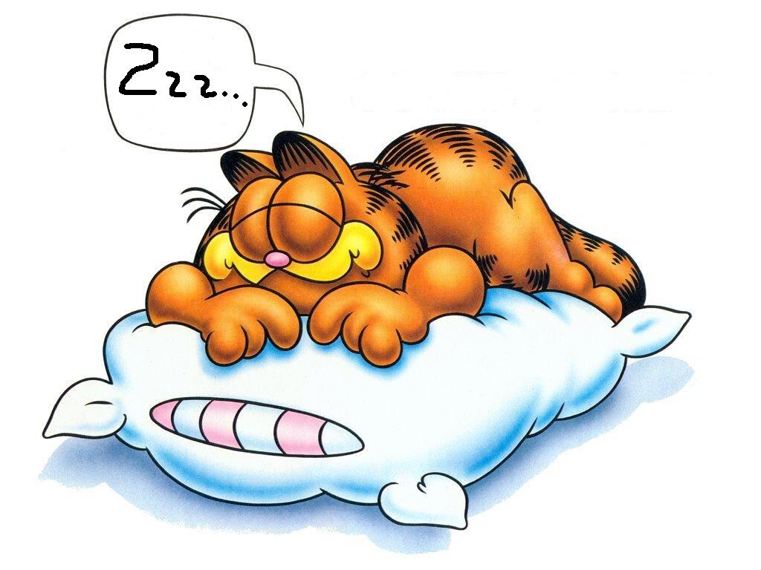
DREAM
(Friedland & Folt, 2009, p. 2)
Dream about solving important problems, making a difference, producing significant papers, and making discoveries.

Slide 13

TAKE YOUR TIME
(Friedland & Folt, 2009, p. 2)
Great ideas do not (usually) appear in thirty-minute windows of time.
When designing a research project, expect to spend lots of time on it. You will!

Slide 14




THINK AND RE-THINK…
WRITE AND REWRITE…

Slide 15
REFERENCES
Booth, W.C., Colomb, G.G., Williams, J.M., Bizup, J., & Fitzgerald, W.T. (2016). The craft of research (4th Ed.). Chicago, IL: The University of Chicago Press.
Friedland, A.J., & Folt, C.L. (2009). Writing successful science proposals (2nd Ed.). New Haven, CT: Yale University Press.
Pyrczak, F., & Bruce, R.R. (2011). Writing empirical research reports (7th Ed.). Glendale, CA: Pyrczak Publishing.

Slide 16
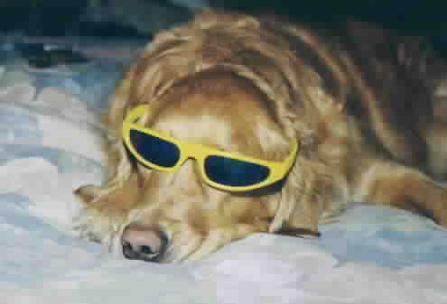
THE DO’S AND DON’TS OF GOOD TECHNICAL WRITING

Slide 17
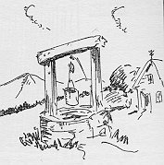
PRE-WRITE
Fill your well.
Have a plan.
Use whatever pre-writing strategies work for you (brainstorming, lists, clustering, outlining).
If necessary, research your topic.

Slide 18
HAVE AN ARROW!
Think of the word arrow rather than thesis.
The word arrow may apply to any type of writing.
What is your point? Can you state it in one short sentence?
When you lose your arrow, your writing becomes vague (go back and fill the well).

Slide 19
ARROW – PART 2
Your “arrow” should pierce each paragraph on some level.
Par. 2
Par. 1
Par. 3
Introduction
Conclusion

Slide 20
USE TRANSITIONS
Give Your Reader Road Signs!
New Idea
Coming Up
Fancy Graph
Ahead!
Whoa! Major
Shift in
Direction!
Conclusion!
Conclusion!
Conclusion!

Slide 21
USE ACTIVE VERBS
Do you know what PASSIVE VOICE means?
Use the Readability Statistics, but don’t rely on them (they miss a lot of passive constructions).
Know when passive verbs are necessary and when they are not!

Slide 22
GET THESE WORDS OUT OF YOUR WRITING!
It (many of you already have fatal it-itis)
Those
There
Them
Which
That
They
Use PRECISE Language

Slide 23
ELIMINATE UNNECESSARY PREPOSITIONAL PHRASES
Prepositional phrases begin prepositions and end with a noun, e.g., to the house, in my yard, for the mayor.
Too many PP phrases make a sentence stringy and set up the potential for dangling modifiers and noun/verb disagreement.

Slide 24
USE STRONG NOUNS AND VERBS
Let active verbs and strong, precise nouns communicate the bulk of your sentences.
Avoid overusing intensifiers such as very, really, actually, virtually, etc.
Remember less is more; reduce the number of adjectives and adverbs in your sentences.

Slide 25
GLOSS FOR COHERENCY
A “gloss” is a short marginal note that sums up a paragraph.
Glossing lets you know if your paragraphs are in the right order.
Glossing lets you know if your paragraphs advance your arrow.

Slide 26

DON’T USE ENGFISH
Engfish is dead language written by the dead for the dead. Write for the living.
Communicate, don’t obfuscate.
Write honestly.
Eliminate filler.

Slide 27
TYPES OF FILLER
Redundant pairs: e.g.,first and foremost, basic and fundamental
Redundant modifiers: e.g., exactly right, true facts, terrible tragedy
Redundant categories: e.g., pink in color, heavy in weight, period of time

Slide 28
MORE FILLER
Metadiscourse (bringing yourself into your writing when there’s no need): e.g., in my opinion, When I do this, after I gave this careful analysis …
Belaboring the obvious: e.g., “I thought to myself” or “Imagine a mental picture of someone engaged in the intellectual activity of trying to learn what the rules are for how to play the game of chess.”

Slide 29
EVEN MORE FILLER - JARGON
Use specialized terminology only when it is necessary.
Use plain language.
Don’t write to impress your audience.

Slide 30
PRETENTIOUS LANGUAGE – TRANSLATE THESE!
In the presence of gravity, that whose Y coordinate increases in a positive sense will, after the vanishing of its time derivative, have its Y coordinate decrease.
Matriculating non-x chromosomal homo sapiens desirous of upper percentile indicators in logocentric discursive pedagogy should eschew utilizing verbiage equivalent to higher monetary amounts where a segment of discourse akin to metallic financial tokens would suffice.

Slide 31
AVOID LONG NOUN STRINGS
Noun strings (series of words all modifying the last noun) are difficult to understand, e.g.:
  Production Enhancement Proposal Analysis Techniques
  Preregistration procedures instruction sheet update

Slide 32
USE BULLETED AND NUMBERED LISTS CORRECTLY
If the sequence matters, use a numbered list.
If the order does not matter, use a bulleted list.
A list should have more than one item

Slide 33
MORE ON LISTS …
Lists should be introduced by a complete statement followed by a colon, e.g.,
  There are three colors in this dress:
      red
      white
      blue
  Not: The three colors are:
      red
      white
      blue

Slide 34
EVEN MORE ON LISTS …
Always use parallel structure in lists
  Example: Non-parallel structure
    I smacked the dog.
    My husband got a kick.
    Shouting at the children.
  Example: Parallel structure
    I smacked the dog.
    I kicked my husband.
    I shouted at my children

Slide 35
SOME FINAL NO-NO’S
Don’t write about something you don’t understand (research or ask questions).
Don’t distort or misrepresent information – EVER.
Don’t use idiomatic words and expressions unless you’re ABSOLUTELY sure everyone in your audience would understand.

Slide 36

AND, FINALLY!
Proofread
Proofread
Proofread

